Slide 1
KFC UI/UX Redesign

Slide 2
Introduction
Good morning everyone. Today, I will present a UI / UX redesign for the KFC Egypt website. My primary goal was to enhance the user experience by solving usability issues found in the four core sections: Home, Eat, Learn, and Family. I focused on making navigation smoother and the interface more intuitive.

Slide 3
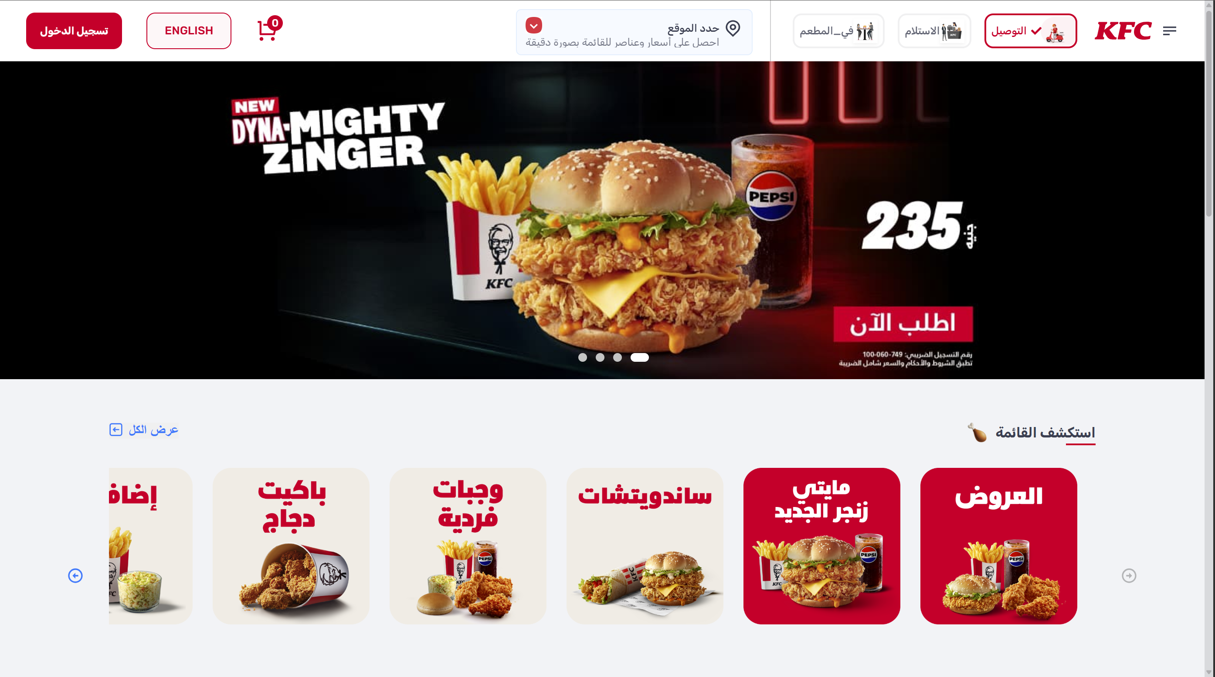
The home page ui/ux problems “Header issues”
1- Header Clutter (Cognitive Overload)
The top navigation bar is overcrowded with too many elements (Login, Language, Cart, Location, Delivery/Pickup) crammed together

Slide 4
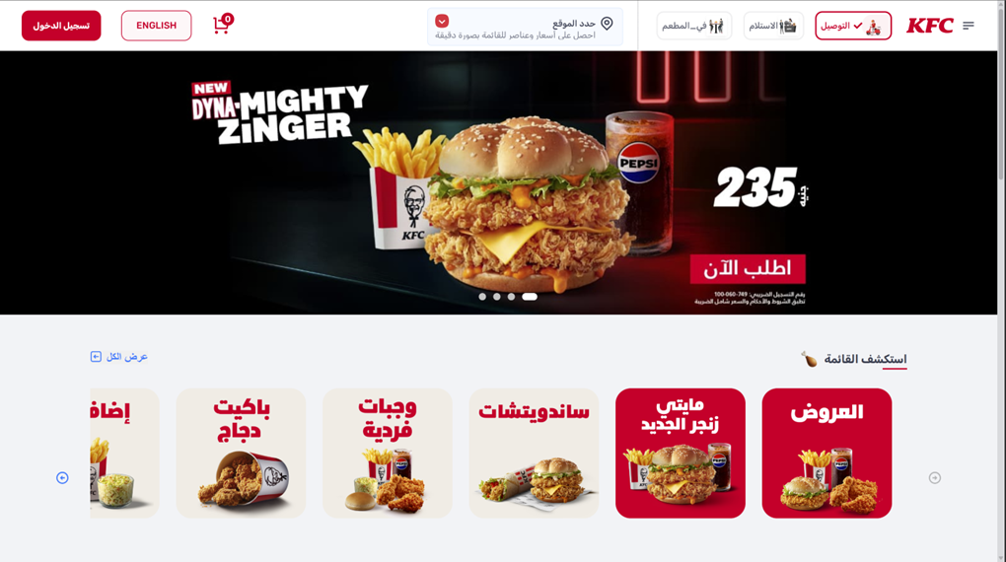
The home page ui/ux problems “Header issues”
2-Poor Visual Hierarchy
There is no clear "Call to Action" (CTA). Since the brand's red color is used everywhere—on buttons, categories, and banners—the "Order Now" button doesn't stand out. A user’s eye isn't naturally guided to the most important action.

Slide 5
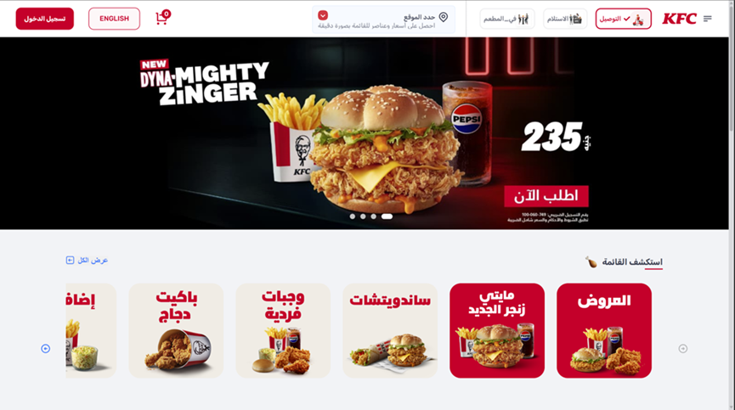
The home page ui/ux problems “Header issues”
3- Weak Navigation Controls
The carousel/slider indicators (the small dots under the main banner) are too tiny, making them hard to see and click, especially on mobile devices. Similarly, the "View All" (عرض الكل) link is tucked away and easily missed.
4- Outdated Category Design
The menu categories use a generic grid layout with basic fonts

Slide 6
The home page ui/ux problems “Body & footer issues”
1. Header Clutter (Cognitive Overload)
The top navigation bar is overcrowded with too many elements (Login, Language, Cart, Location, Delivery/Pickup) crammed together.
2. Poor Visual Hierarchy
There is no clear "Call to Action" (CTA). Since the brand's red color is used everywhere—on buttons, categories, and banners—the "Order Now" button doesn't stand out.
3. Weak Navigation Controls
The carousel/slider indicators (the small dots under the main banner) are too tiny, making them hard to see and click, especially on mobile devices. Similarly, the "View All" (عرض الكل) link is tucked away and easily missed.
4. Outdated Category Design
The menu categories use a generic grid layout with basic fonts.

Slide 7
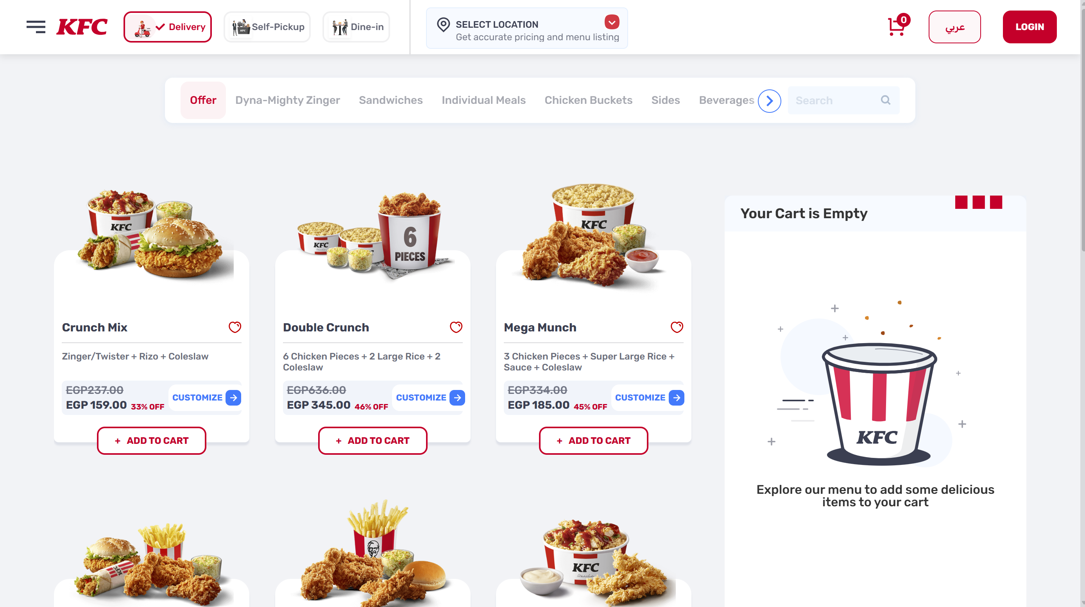
The meny page ui/ux problems
1. Product Card Issues
Information overload: Each meal card includes the meal name, ingredients, old price, new price, discount percentage, a Customize button, and a favorite (heart) icon.
2. Poor Empty State Management (White Space Waste)
Empty cart section: The “Your Cart Is Empty” area occupies a large portion of the right side (nearly one-third of the screen) without delivering meaningful value.
3. Pricing Hierarchy
Discount clarity: The crossed-out old price and discount percentage (e.g., 33% OFF) are placed directly next to the new price and appear almost the same size, which can cause quick visual confusion.

Slide 8
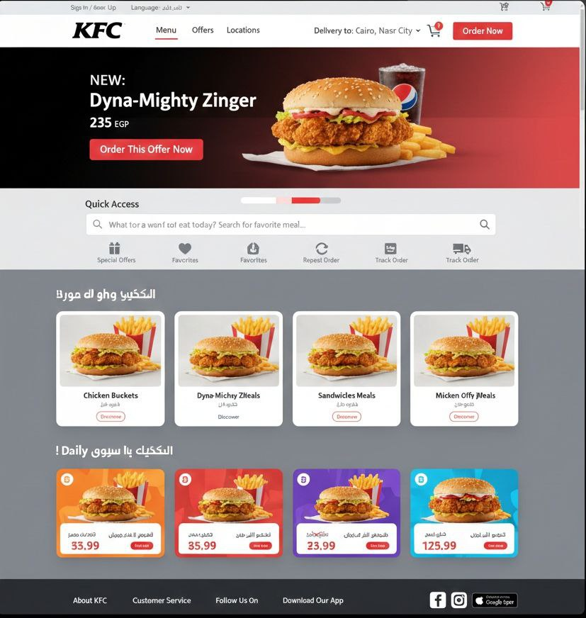
استكشف القائمه

Slide 9
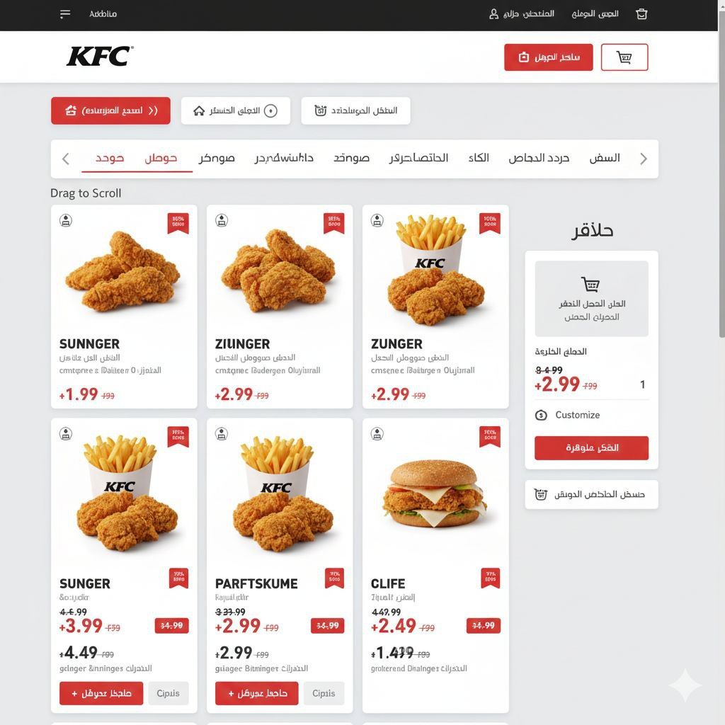
MENU
MAIN PAGE
BASKET
MAIN PAGE
Offer Dyna-Mighty Zinger Sandwiches Individual Meals Chicken Buckets Sides
Zinger
Zinger
Zinger
65,00 EGP
65,00 EGP
85,00 EGP
55.00 EGP
55.00 EGP
75.00 EGP
Zinger
Zinger
Zinger
85,00 EGP
85,00 EGP
155,00 EGP
75.00 EGP
75.00 EGP
135.00 EGP

